Slide 1
Deployment System Development for MSLED
Jonathon Houda
Mentor: Dr. Alberto Behar
Space Grant Symposium
University of Arizona, Tucson, AZ
April 12th, 2014
Arizona State University
Extreme Environments Robotics and Instrumentation Laboratory
MSLED Deployment

Slide 2
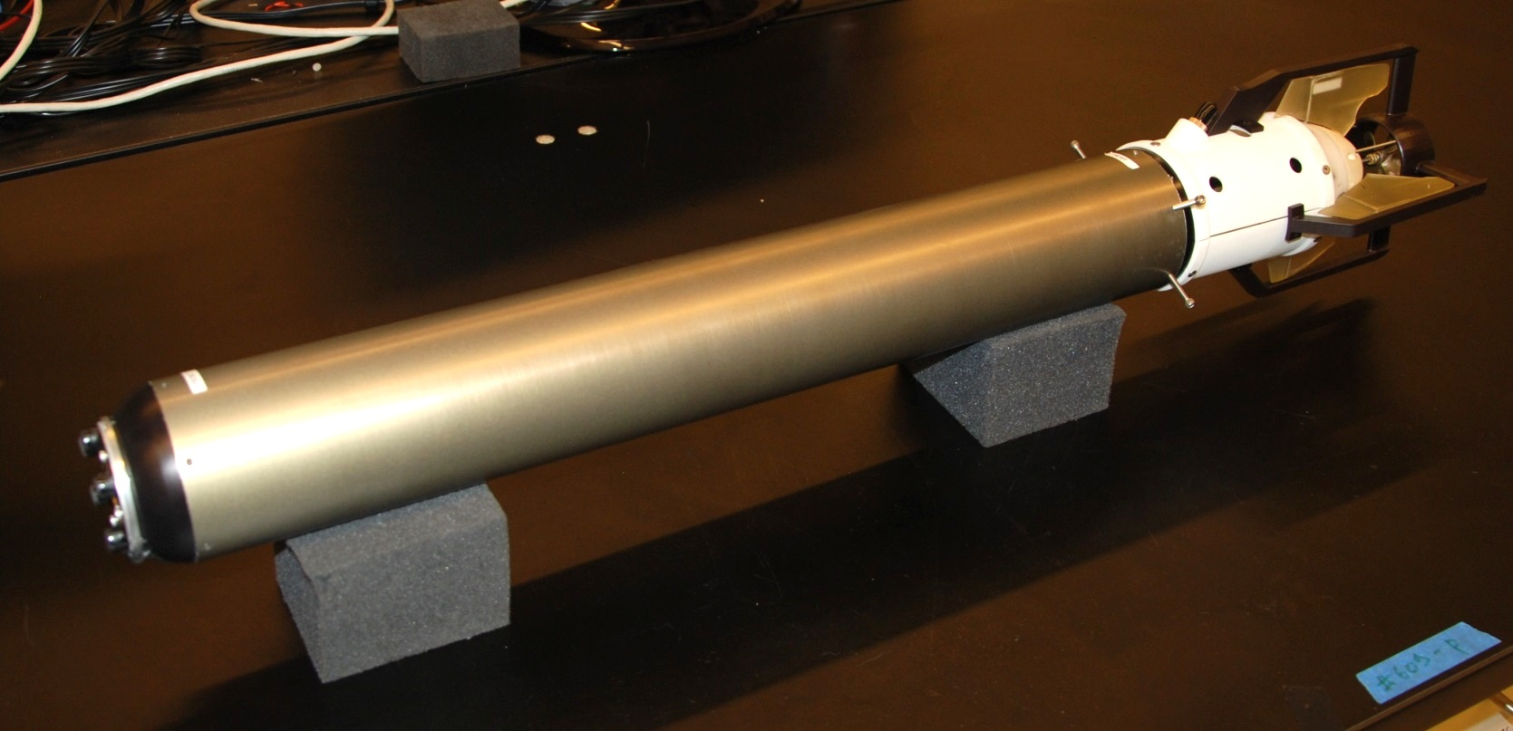
MSLED
Micro Subglacial Lake Exploration Device
Arizona State University
Extreme Environments Robotics and Instrumentation Laboratory
MSLED Deployment

Slide 3
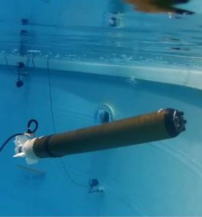
MSLED
Small “torpedo” shaped robotic submersible
Capable of withstanding pressures at 1km under water
Used for Antarctic observation and data retrieval of subglacial lakes.
Arizona State University
Extreme Environments Robotics and Instrumentation Laboratory
MSLED Deployment

Slide 4
Purpose of Project
To develop a reliable method for deploying MSLED from Mothership
Requirements:
MSLED located beneath Mothership
Small deployment height (<2m) and width (<30cm)
Simple as possible to minimize failures
Mothership
Deployment Rig
MSLED
3D rendering of MSLED in deployment rig attached to Mothership
Arizona State University
Extreme Environments Robotics and Instrumentation Laboratory
MSLED Deployment
Notes:
Hole drilled in ice, MSLED and Mothership lowered down
At depth, MSLED is released

Slide 5
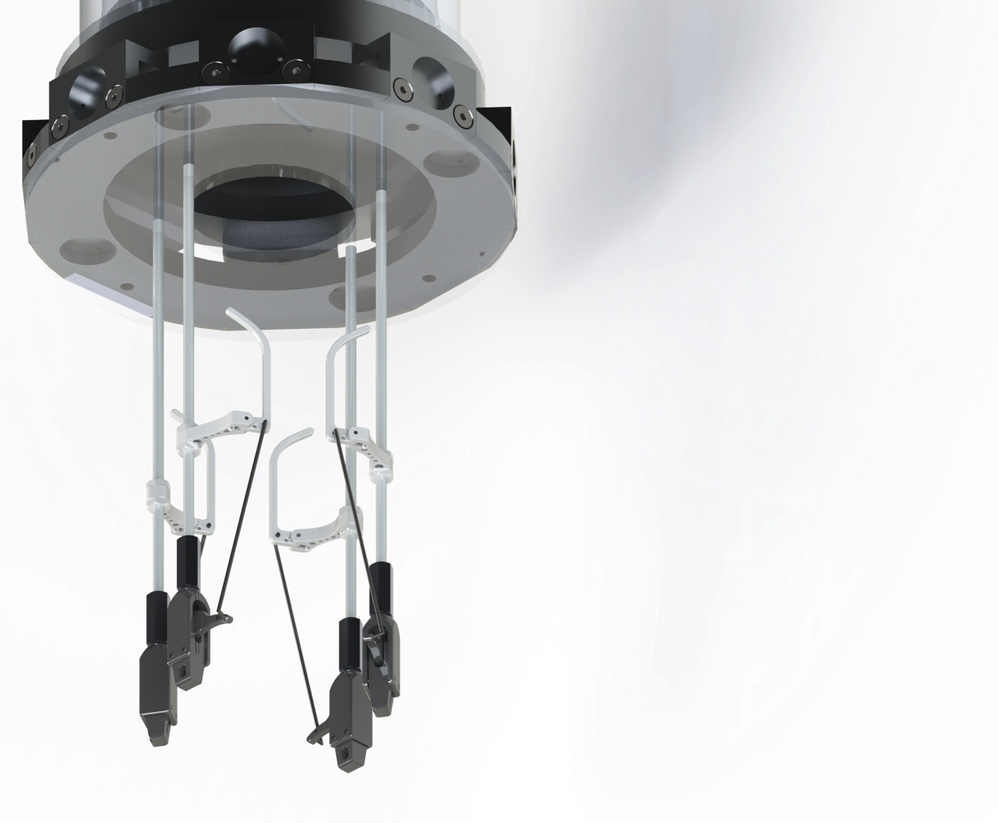
Deployment System Design
Four latches hold MSLED securely
Physically restrains MSLED, prevents bouncing/floating away
Actuating two fins releases individual latches
Spring return on each latch prevents accidental deployment
Mothership
Levers (actuated by fins)
Latches (attach to MSLED Hull)
Deployment mechanism rendering
Arizona State University
Extreme Environments Robotics and Instrumentation Laboratory
MSLED Deployment

Slide 6
Deployment Video
Arizona State University
Extreme Environments Robotics and Instrumentation Laboratory
MSLED Deployment

Slide 7
Conclusions
Created a reliable method for deployment of MSLED
More full system testing to be done
Deployment in 2014/2015 Antarctic summer season at Lake Whillians
Arizona State University
Extreme Environments Robotics and Instrumentation Laboratory
MSLED Deployment

Slide 8
Questions?
Arizona State University
Extreme Environments Robotics and Instrumentation Laboratory
MSLED Deployment

